Slide 1
DISTRIBUTED CROWDFUNDING SYSTEM USING BLOCKCHAIN
Guide Name: Dr. N.Pughazendi
Team Members : SRIRAM S(211418104269) SRIRAM S(211418104268) PRABAKAR(211418104191) Batch No: C7

Slide 2
Introduction
Charity is considered a moral obligation throughout the world, and a huge amount of money comes into circulation in the name of charity.
In most cases, the charity collection processes are not transparent, and due to this, the charitable organizations struggle to gain donors’ trust and interest.
This apprises the need for a solution to these problems so as to make crowdfunding system and spending transparent for the grantmakers.
This need could be fulfilled by a blockchain-based system. We present a blockchain-based crowdfunding system that aims to provide a transparent, secure, auditable, and efficient system.
This system help charities enlist their names so that the investors can verify the legitimacy of the charities in case they have already invested earlier in order to avoid false/fake charities.
Once the charities are listed people can start sending donations where the donations get saved in a smart contract as crypto.

Slide 3
Literature survey
S.NO | TITLE | TECHNIQUE | ADVANTAGES | DISADVANTAGE
1. | Developing a Reliable Service System of Charity Donation During the Covid-19 Outbreak | Ethereum blockchain | It provides an automated way of managing the donations in secure manner | Not cost-effective, Can be complex to use by a user

Slide 4
Literature survey
S.NO | TITLE | TECHNIQUE | ADVANTAGES | DISADVANTAGE
2. | Platform for Tracking Donations based on Blockchain Technology | Smart Contract | Blockchain approach for safeguarding and integrity | The prototype built shows less precision and work inefficiently

Slide 5
Literature survey
S.NO | TITLE | TECHNIQUE | ADVANTAGES | DISADVANTAGE
3. | Developing a Reliable Service System of Charity Donation During the Covid-19 Outbreak. | Blockchain Technology | The system designed in the project was developed and implemented using Python, Flask framework with capability and ability to handle challenges fraud transactions and can speedily execute blocks and mine within the Blockchain | Reduced data transfer speed

Slide 6
Literature survey
S.NO | TITLE | TECHNIQUE | ADVANTAGES | DISADVANTAGE
4. | Research on Charity System Based on Blockchain | blockchain technology | All transactions are recorded on the blockchain to realize traceability of funds, which increase the transparency of charities | May be time-consuming

Slide 7
Problem Statement
Charity is a highly growing sector in today’s world and it has evolved from its traditional organizational concepts to a decentralized crypto-currency based system.
In this fast developing world of modernization, some people are becoming too competitive to earn money while others have no clue about getting even a penny.
But at the same time, there exist people who wish to contribute to the society out of altruism.
There exist many online donation platforms in the world and yet issues concerning extra fees, accountability and processing delay still exist as well as these existing centralized systems for charities are so corrupt that people lose belief in these trustless systems and hence the charities become failure.

Slide 8
Development Environment
HARDWARE REQUIREMENTS -
Processor : Pentium Dual Core 2.00GHZ
Hard disk : 120 GB
RAM : 2GB (minimum)
SOFTWARE REQUIREMENTS -
Operating system : Windows7 (with service pack 1), 8, 8.1 and 10
IDE : Visual Studio Code
Backend : Node Js
Frontend : React

Slide 9
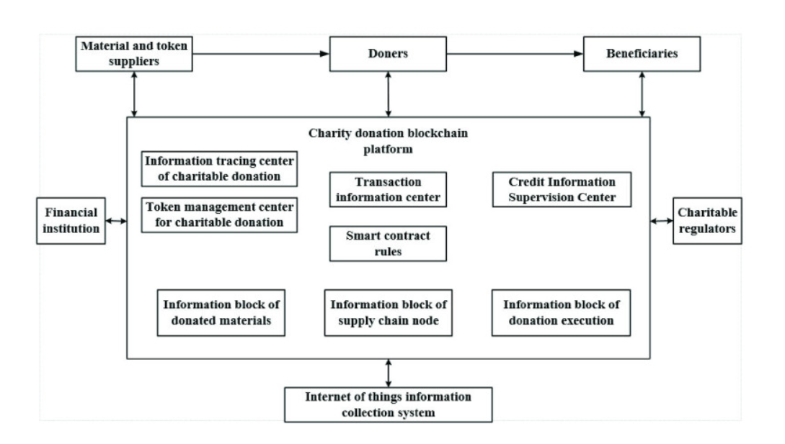
System Architecture

Slide 10
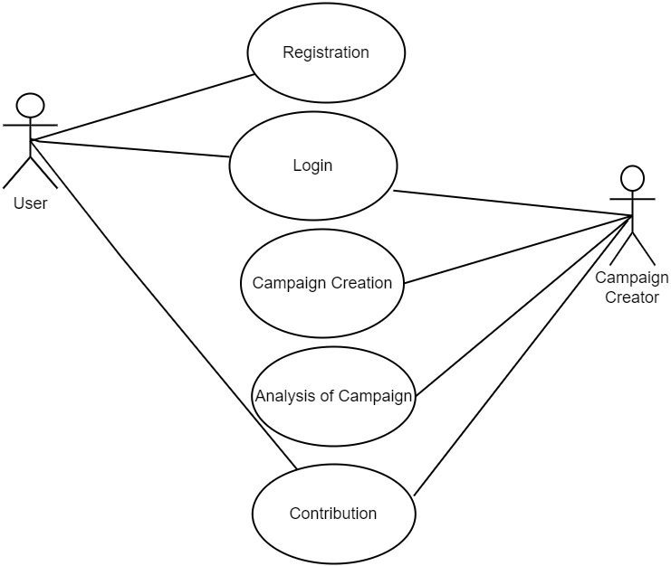
Use Case Diagram

Slide 11

DFD (Level 1)

Slide 12
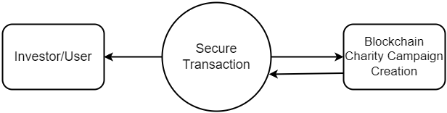
DFD (Level 0)

Slide 13
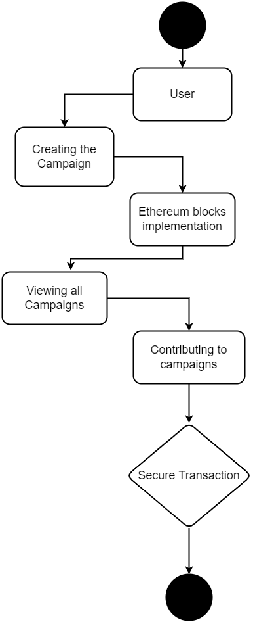
Activity Diagram

Slide 14
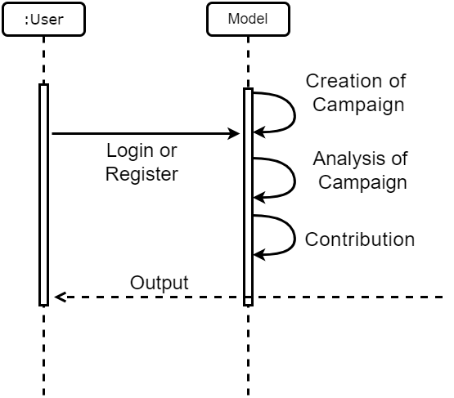
Sequence Diagram

Slide 15
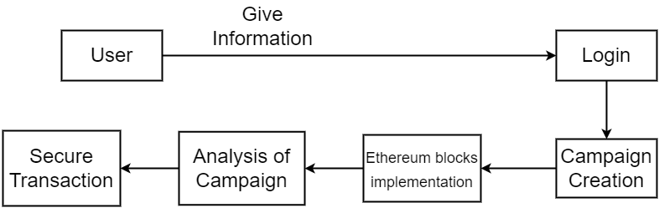
Collaboration Diagram

Slide 16
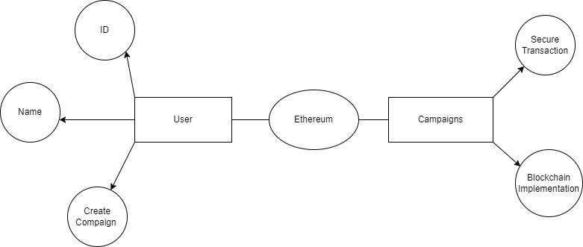
ER Diagram

Slide 17
Module Explanation
Campaign creation
Analysis of campaign
Contribution

Slide 18
Campaign creation
In the first stage a project manager creates new project by mentioning the name of the project, the description of the project and the minimum contribution to that project.
And the contributors then can view the all the open projects in fundraising and charity platform and can choose any project for which they want to contribute.
To mark themselves as contributors, they have to invest minimum contribution for that project which project manager has mentioned while creating the project.
And this money is added to the wallet which can be used by the project mangers.

Slide 19
Analysis of campaign
In this stage, if a project manager wants to spend the money contributed by investors, then they have to create the spending request by giving the description about where they are going to spend the money, the total amount they are going to spend and the address of the vendor who will supply the things required by the project manager.
For creating a campaign, a campaign name, campaign creator’s name, single line description, detailed description, a banner image and a campaign video is required.
Then he has to decide how many tokens he would like to give away and the price, name and symbol of each token.
He also needs to give his Ethereum wallet address to receive the funds once his campaign is successful.

Slide 20
Contribution
An investor who lands on the fundraising and charity app platform can browse through all the campaigns, search or sort the campaigns based on his interests and invest ether to support 15 his favorite campaign.
The investor needs to have a sufficient amount in his wallet to invest and pay for the transaction (gas) to be mined.
Once the project is successful, he can claim the campaign-specific tokens depending upon the criteria specified by the creator.
If the campaign fails, he can claim his refund of ether that he had invested in that specific campaign.

Slide 21
Testing
TEST NO. | INPUT | EXPECTED BEHAVIOUR | TESTING | STATUS
1 | User creating an campaign using valid data | Campaign created | Unit Testing | Pass
2 | User creating an campaign using invalid data | Campaign not created | Unit Testing | Fail
3 | Contributing to Campaign using valid amount | Contribution added | Output Testing | Pass
4 | Contributing to Campaign using invalid amount | Contribution not added | Output Testing | Fail

Slide 22
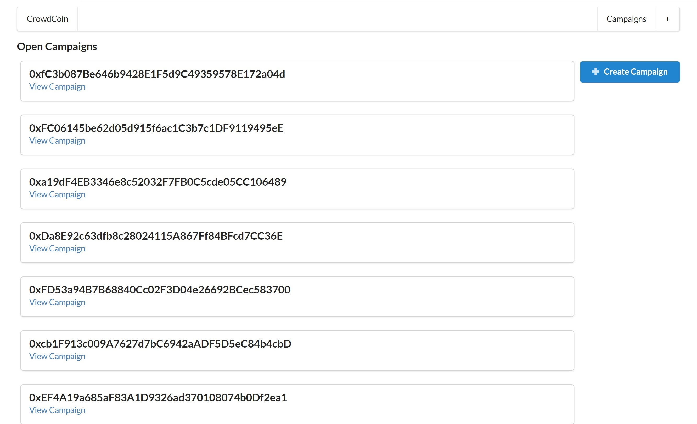
Screenshots

Slide 23
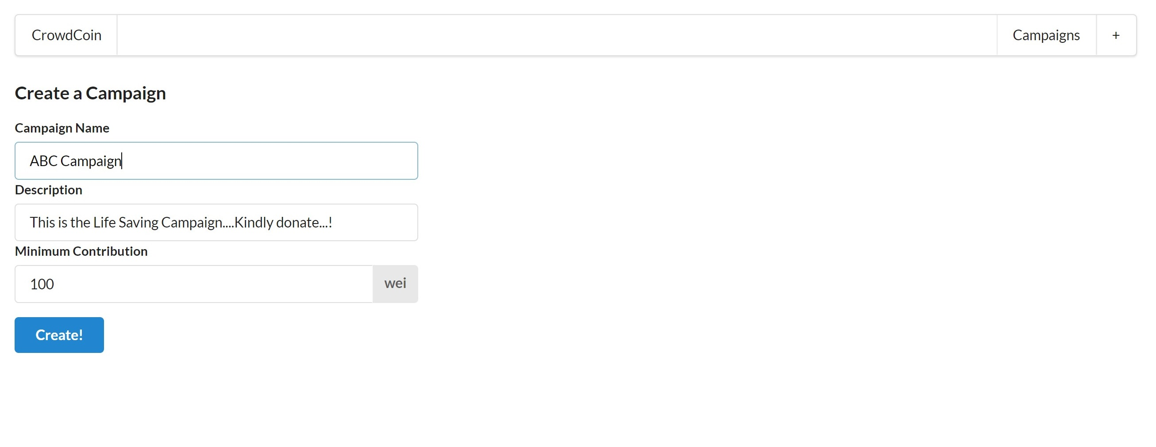
Screenshots

Slide 24
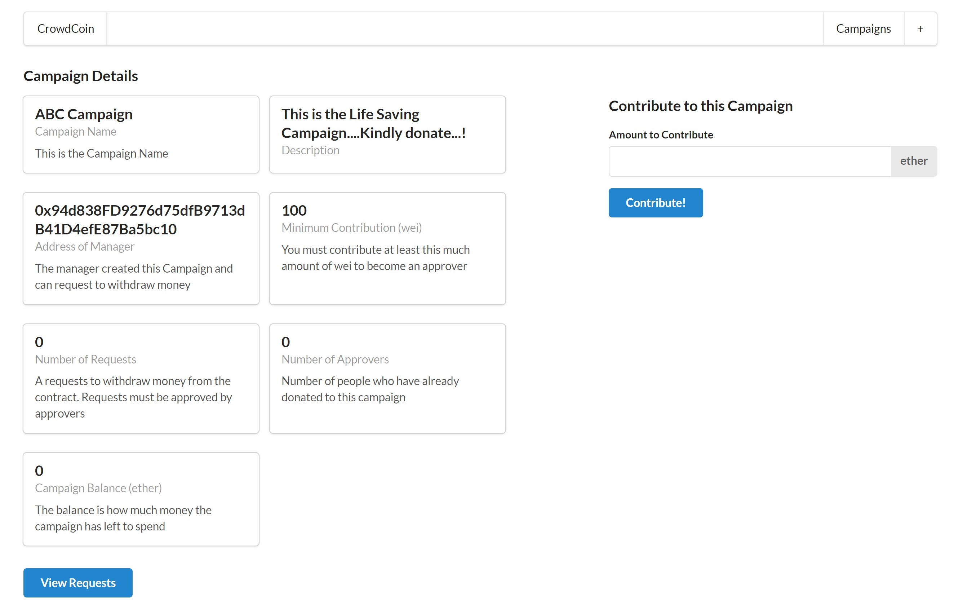
Screenshots

Slide 25
Conclusion
Our system is a combination of blockchain technology and philanthropy, where a charity-based platform for blockchain was introduced.
By incorporating blockchain into recording charitable donations, donors will be able to track exactly where their donations go and when they are put into use.
Blockchain will provide greater transparency behind nonprofit organizations and give both donors and operators greater accountability when it comes to how donations are spent.
With blockchain-based charities, the number of middlemen between donors and those they want to help is brought to a minimum, which allows a greater portion of donations to be given to those in need.
Utilizing blockchain to record these funds and their uses also generates an unalterable digital receipt of funds and improves organizations’ credibility.

Slide 26
References
Darshan M; S.R Raswanth; Sundeep V V S Akella; Priyanka Kumar “A Secured Distributed Ledger Based Fundraising Framework Using Smart Contracts” 2021, IEEE
Gubaev Renat; Anton Peresichansky; Alexandr Belenov; Artem Barger “Karma - blockchain based charity foundation platform”, 2021 IEEE
Pratyush Agarwal; Shruti Jalan; Abhijit Mustafi “Decentralized and financial approach to effective charity”, 2018, IEEE
Eisa Shaheen; Mohamed Abdl Hamed; Walaa Zaghloul; Eman Al Mostafa “A Track Donation System Using Blockchain”, 2021 IEEE
N. Sai Sirisha; Tarasha Agarwal; Ranjeet Monde; Richa Yadav; Rupali Hande “Proposed Solution for Trackable Donations using Blockchain”, 2019 IEEE

Slide 27
Iqra Khalil; Omer Aziz; Numan Asif “Blockchain and Its Implementation for Charitable Organizations, 2021 IEEE
Shweta Jain; Rahul Simha “Blockchain for the Common Good: A Digital Currency for Citizen Philanthropy and Social Entrepreneurship”, 2018 IEEE
Aashutosh Singh; Rohan Rajak; Harsh Mistry; Prachi Raut “Aid, Charity and Donation Tracking System Using Blockchain, 2020 IEEE
Mehmet Demir; Ozgur Turetken; Alexander Ferworn “Blockchain-Based Transparent Disaster Relief Delivery Assurance, 2020 IEEE
Hadi Saleh; Sergey Avdoshin; Azamat Dzhonov “Platform for Tracking Donations of Charitable Foundations Based on Blockchain Technology”, 2019 IEEE

Slide 28
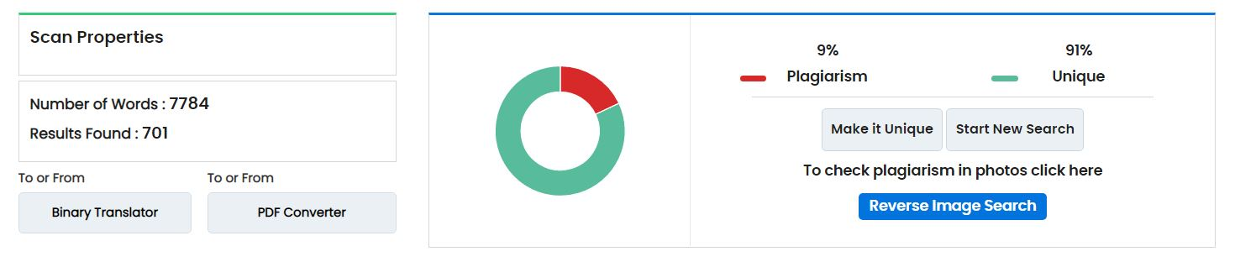
Plagiarism Report

